Slide 1
Automate hybrid and cloud environments using Azure Automation
Jan Egil Ring
Notes:
This is the slide shown before the presentation starts. When you are ready to go, tell the video operator to start the recording, and click to the next slide.

Slide 2
5
Video operator, did you start the recording?
Notes:
[REQUIRED SLIDE]
These slides are mandatory and help us with video post-processing. Please keep them as they are.

Slide 3
4
Notes:
[REQUIRED SLIDE]

Slide 4
3
Notes:
[REQUIRED SLIDE]

Slide 5
2
Notes:
[REQUIRED SLIDE]

Slide 6
1
Notes:
[REQUIRED SLIDE]

Slide 7
Automate hybrid and cloud environments using Azure Automation
Jan Egil Ring
Notes:
This is the slide shown before the presentation starts. When you are ready to go, tell the video operator to start the recording, and click to the next slide.

Slide 8
This Session
Learn how to leverage Azure Automation for cloud and hybrid management
Understand how Azure Automation differs from other automation capabilities in Azure
Notes:
Please invest some time to reconsider your session: what is it that audience can get out of it? Try and be as precise as you can. If you are showing solutions, then focus on “how to”. If you present about a general technology, you’ll want to stick to “Be able to” or “Understand why/how”.

Slide 9
Agenda
Overview of automation capabilities in Azure
Azure Automation capabilities
Demos, demos and demos

Slide 10


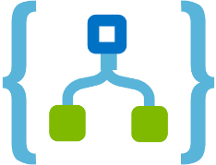

Automation
Deploy and operate infrastructure and services in Azure
Deploy
Respond
Orchestrate
Deliver repeatable and consistent infrastructure as code for testing, staging, and production.
Create event-based automation on deployed resources to diagnose and resolve issues.
Orchestrate your automation across disparate systems in Azure and 3rd party management.
Resource Manager
Automation
Event Grid
Functions
Logic Apps
Notes:
Functions: React to timers, HTTP, or events from your favorite Azure services, with more on the way
Author functions in C#, F#, Node, Java, Python, PowerShell, and more
Send results to an ever-growing collection of services
When Microsoft launched Azure Automation Runbooks in early 2014, it was the only Azure service that could deploy, operate, and integrate your Azure and on-premises resources. Over the last few years, they have built additional services that are optimized for specific scenarios. These include:
Functions
Logic Apps
Desired State Configuration (part of Automation)
Resource Manager
Deployment Manager
Blueprints
Policy
DevOps
The general guidance is to use these new services for their domain specific work and use Azure Automation runbooks for things that can not be done with the above services (hybrid worker functionality for specific compute requirements).
For Azure Functions, the main scenario is around “Event based automation”. If you are looking to deliver your automation based on events (which is a growing scenario), then I would use Functions as they are optimized for these scenarios (triggers & bindings).
Runbooks = Long lived/long duration tasks in cloud / back on premises (Akin to Scheduled Task runners for Systems Automation purposes)
Logic Apps = Complex Integration Tasks
Functions = Short Lived/Transformation tasks, that do smaller scale work with simple input output
All Combined = Flexibility and scalability where needed

Slide 11

Azure Automation
Update Management
Configuration Management
Process Automation
Assess, deploy, and verify updates on your machines
Set, track, and control your in-guest configuration
Orchestrate tasks across your environment
Notes:
Update Management
Windows and Linux
Manage updates at scale
Log Analytics and PowerBI (or Grafana)
Configuration Management
Desired State Configuration
Change Tracking (detect changes, such as file content or status of a critical service)
Inventory (discover the state of your environment, such as which software is installed)
Process Automation
Orchestrate tasks across your environment with runbooks, based on PowerShell or Python
Supports hybrid runbook workers for hybrid scenarios (no VPN required)
Global assets such as variables and credentials

Slide 12
Azure Automation

Slide 13
Summary
Azure Automation
Update Management
Configuration Management
Process Automation
Use new services (Functions, Event Grid, etc) for domain specific scenarios, and Azure Automation for other automation scenarios

Slide 14
Notes:
[REQUIRED SLIDE]
Make sure you provide all materials that audience needs to reproduce your demos.
Either upload them as a PowerShell module to www.powershellgallery.com (preferred for reusable functions)
Or, upload them to our github repository (ask the girls at the info desk to provide you with access)
Or, upload them to your own github repository
Please make sure all materials are available by the time your presentation starts, or at minimum upload them right after your presentation

Slide 15
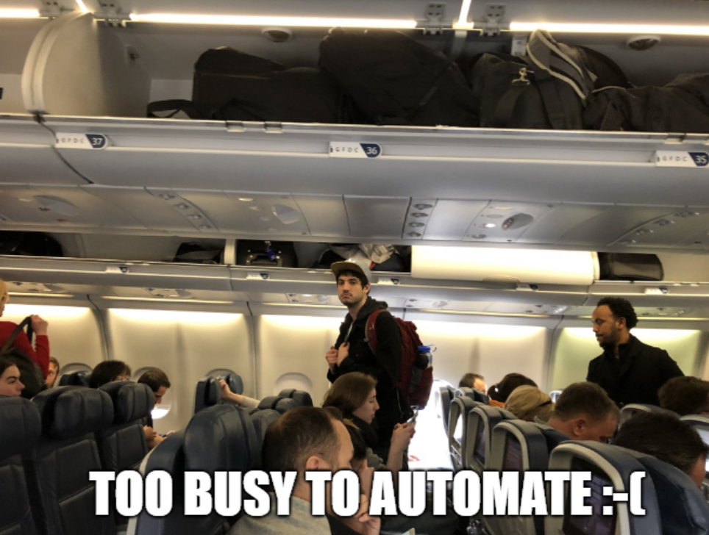
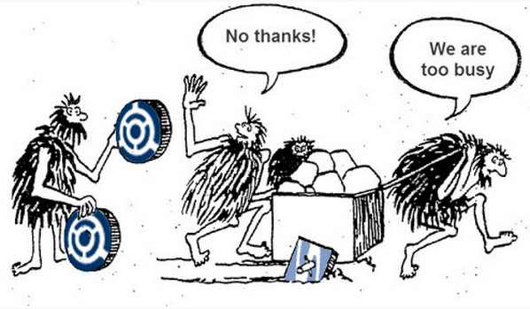
Key takeaways

Slide 16
Notes:
[REQUIRED SLIDE]
If you sticked to your timing, you now have 15 min left for Q&A. If you missed your timing, you will have to leave the room when your slot is over. In this case, invite your audience to the coffee break and offer to cover questions there.
IN ANY CASE please point your audience to the conference app and the session voting. By the time the conference opens, the eventraft app *should* have the option to vote on sessions.
Please MAKE SURE you leave your room when your slot is over. The next speaker would like to set him/herself up and get everything up and running.

Slide 17
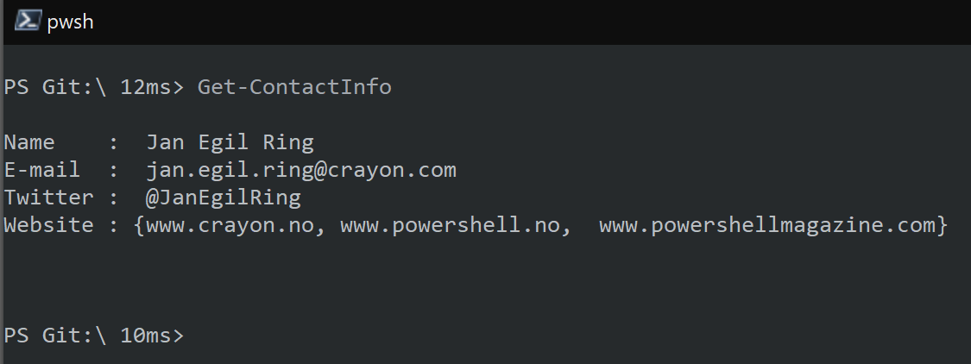
about_Speaker
Notes:
function Get-ContactInfo {
[pscustomobject] @{
Name = ' Jan Egil Ring '
'E-mail ' = ' jan.egil.ring@crayon.com'
Twitter = ' @JanEgilRing '
Website = @('www.crayon.no', 'www.powershell.no'
' www.powershellmagazine.com')
} | Format-List
}
Get-ContactInfo

